Slide 1
‘The Hanky’ Campaign Assets: Arabic, Mandarin/Simplified Chinese, Vietnamese October 7 – November 16, 2024
Tip: Open this document in the desktop app for best results.

Slide 2
Contents
For each language, you will find:
Material | Type | Instructions
15-sec video Quitline call to action | YouTube link | Use the YouTube link to share the video on your channels.
15-sec video Doctor call to action | YouTube link | Use the YouTube link to share the video on your channels.
30-sec video Quitline call to action | YouTube link | Use the YouTube link to share the video on your channels.
30-sec video Doctor call to action | YouTube link | Use the YouTube link to share the video on your channels.
Social media tiles and sample posts | .gif files | Included in .zip folder. Click button below to download folder and access files in all three languages:
Posters: Poster 1: ‘The Hanky’ campaign poster Poster 2: Quitline poster Poster 3: Multi-language Quitline poster | Order hardcopies | Order hardcopies via the online order resource form:
Sample website/newsletter copy | Text in slide | Copy and paste the in-language text to your channels. English translation included here for your reference.
Campaign landing page quit.org.au/Arabic OR Chinese OR Vietnamese | Text in slide | Link to the landing page for each language. English translation included here for your reference.
Download social media assets (.zip folder)
Order poster hardcopies

Slide 3
Arabic Creative

Slide 4
Copying and pasting Arabic text
Arabic is read from right to left. To select Arabic text, highlight text from top right to bottom left (like how you would read it).
If pasting into social media platforms such as Facebook, LinkedIn and X:
These platforms recognise text is Arabic and automatically aligns the text correctly.
If pasting into a Word document:
Copy text by highlighting text from top right to bottom left (like how you would read it).
To paste, right-click onto the page in your Word document and select ‘Keep text only’ under Paste Options
Highlight the pasted text and right-align.
Tip: Open this document in the desktop app for best results.

Slide 5
Video
15s - Quitline
Arabic is read from right to left. To select Arabic text, highlight text from top right to bottom left (like how you would read it).
Script:
Smoking causes respiratory illnesses like emphysema, chronic bronchitis and lung cancer. Even smoking once a day can have consequences. For help to quit, contact Quitline. | يسبّب التدخين أمراضًا في الجهاز التنفسي مثل الانتفاخ الرئوي والتهاب الشعب الهوائية المزمن وسرطان الرئة. حتى التدخين مرة واحدة في اليوم يمكن أن يكون له عواقب. للحصول على المساعدة في الإقلاع عن التدخين، اتصل بخط Quitline.
Super:
Every cigarette is doing you damage. For help to quit, contact Quitline (03) 8583 2905 (03) 8583 2905 / quit.org.au/arabic | كل سيجارة تسبّب لك ضررًا. للمساعدة في الإقلاع عن التدخين، اتصل بخط Quitline على الرقم 0385832905 0385832905 / quit.org.au/arabic
Share this link:
https://youtu.be/IsKXugexMyw
Use the YouTube link to share the video on your channels.
Remember to tag and follow Quit on: Facebook and X (formerly Twitter) @quitvic | LinkedIn @quit-victoria

Slide 6
Video
Arabic is read from right to left. To select Arabic text, highlight text from top right to bottom left (like how you would read it).
15s - Doctor
Script:
Smoking causes respiratory illnesses like emphysema, chronic bronchitis and lung cancer. Even smoking once a day can have consequences. Speak to your doctor about quitting. | يسبّب التدخين أمراضًا في الجهاز التنفسي مثل الانتفاخ الرئوي والتهاب الشعب الهوائية المزمن وسرطان الرئة. حتى التدخين مرة واحدة في اليوم يمكن أن يكون له عواقب. تحدّث إلى طبيبك حول الإقلاع عن التدخين.
Super:
Every cigarette is doing you damage. For help to quit, speak to your doctor. quit.org.au/arabic | كل سيجارة تسبّب لك ضررًا. للحصول على المساعدة في الإقلاع عن التدخين، تحدّث إلى طبيبك. quit.org.au/arabic
Share this link:
https://youtu.be/l2OkAhr-KU0
Use the YouTube link to share the video on your channels.
Remember to tag and follow Quit on: Facebook and X (formerly Twitter) @quitvic | LinkedIn @quit-victoria

Slide 7
Video
Arabic is read from right to left. To select Arabic text, highlight text from top right to bottom left (like how you would read it).
Script:
Smoking causes toxic particles from cigarettes to deposit directly in the lungs, which causes immense damage. The lung damage that smoking causes can lead to respiratory illnesses including emphysema, chronic bronchitis and lung cancer. Even smoking once a day can have serious consequences. For help to quit contact Quitline on (03) 8583 2905 | يؤدي التدخين إلى ترسّب الجزيئات السامة الناتجة عن السجائر في الرئتين مباشرةً، مما يسبّب أضرارًا جسيمة. يمكن أن يؤدي الضّرر الذي يسبّبه التدخين للرئتين إلى أمراض في الجهاز التنفسي بما في ذلك الانتفاخ الرئوي والتهاب الشعب الهوائية المزمن وسرطان الرئة. حتى التدخين مرة واحدة في اليوم يمكن أن يكون له عواقب وخيمة. للمساعدة في الإقلاع عن التدخين، اتصل بخط Quitline على الرقم 0385832905
Super:
Every cigarette is doing you damage. For help to quit, contact Quitline (03) 8583 2905 (03) 8583 2905 / quit.org.au/arabic | كل سيجارة تسبّب لك ضررًا. للمساعدة في الإقلاع عن التدخين، اتصل بخط Quitline على الرقم 0385832905 0385832905 / quit.org.au/arabic
30s - Quitline
Share this link:
https://youtu.be/nvRgUIo8Gik
Use the YouTube link to share the video on your channels.
Remember to tag and follow Quit on: Facebook and X (formerly Twitter) @quitvic | LinkedIn @quit-victoria

Slide 8
Video
Arabic is read from right to left. To select Arabic text, highlight text from top right to bottom left (like how you would read it).
30s- Doctor
Script:
Smoking causes toxic particles from cigarettes to deposit directly in the lungs, which causes immense damage. The lung damage that smoking causes can lead to respiratory illnesses including emphysema, chronic bronchitis and lung cancer. Even smoking once a day can have serious consequences. For help to quit, speak to your doctor. | يؤدي التدخين إلى ترسّب الجزيئات السامة الناتجة عن السجائر في الرئتين مباشرةً، مما يسبّب أضرارًا جسيمة. يمكن أن يؤدي الضّرر الذي يسبّبه التدخين للرئتين إلى أمراض في الجهاز التنفسي بما في ذلك الانتفاخ الرئوي والتهاب الشعب الهوائية المزمن وسرطان الرئة. حتى التدخين مرة واحدة في اليوم يمكن أن يكون له عواقب وخيمة. للحصول على المساعدة في الإقلاع عن التدخين، تحدّث إلى طبيبك.
Super:
Every cigarette is doing you damage. For help to quit, speak to your doctor. quit.org.au/arabic | كل سيجارة تسبّب لك ضررًا. للحصول على المساعدة في الإقلاع عن التدخين، تحدّث إلى طبيبك. quit.org.au/arabic
Share this link:
https://youtu.be/GcQScWzb4nQ
Use the YouTube link to share the video on your channels.
Remember to tag and follow Quit on: Facebook and X (formerly Twitter) @quitvic | LinkedIn @quit-victoria

Slide 9
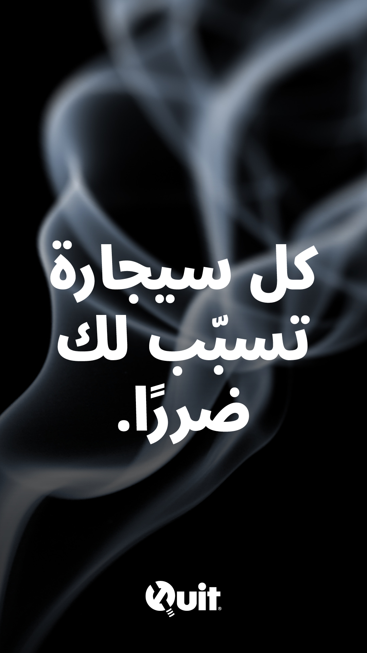
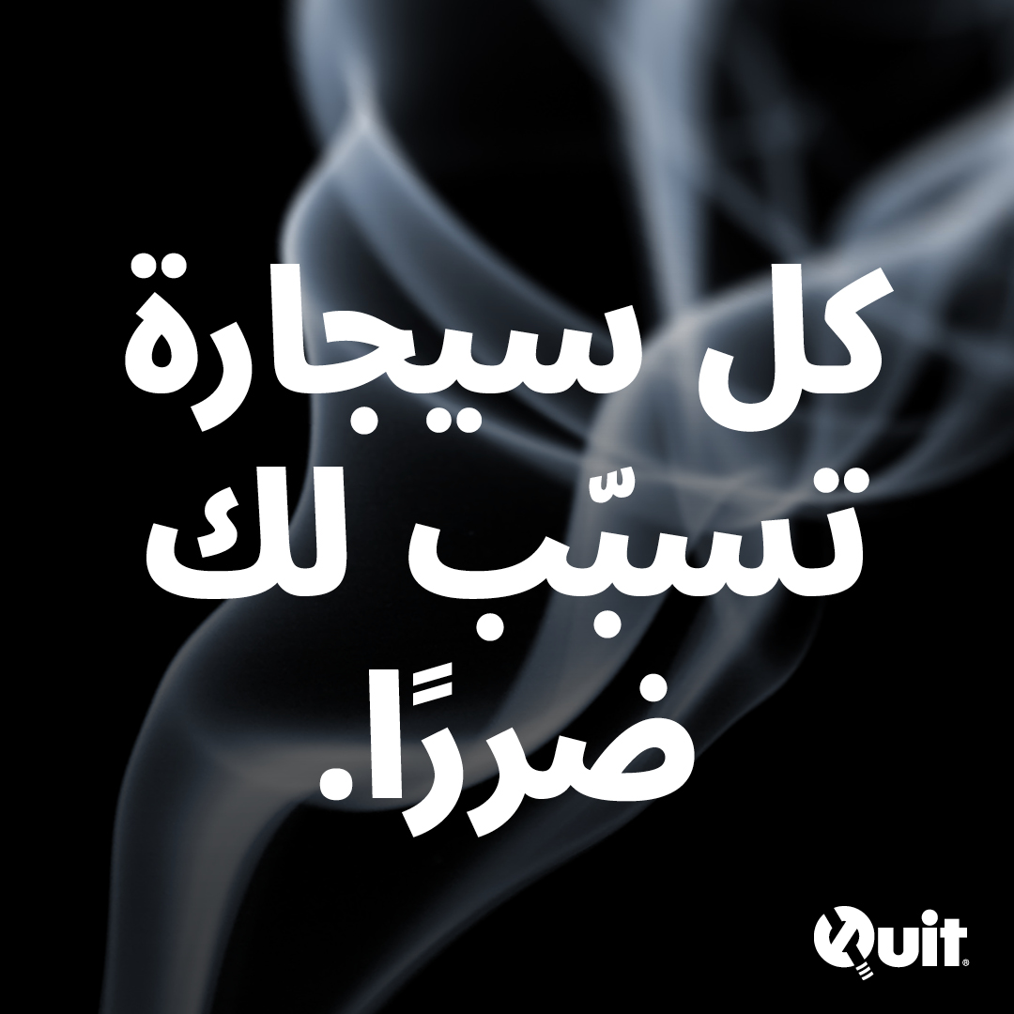
Social media tiles & sample posts:
Remember to tag and follow Quit on: Facebook and X (formerly Twitter) @quitvic | LinkedIn @quit-victoria
Arabic is read from right to left. To select Arabic text, highlight text from top right to bottom left (like how you would read it).
Headline:
It’s time to quit. | لقد حان الوقت للإقلاع عن التدخين.
Body Copy:
The lung damage that smoking causes can lead to respiratory illnesses including emphysema, chronic bronchitis and lung cancer. | يمكن أن يؤدي الضّرر الذي يسبّبه التدخين للرئتين إلى أمراض في الجهاز التنفسي بما في ذلك الانتفاخ الرئوي والتهاب الشعب الهوائية المزمن وسرطان الرئة.
Tile Copy:
Every cigarette is doing you damage. | كل سيجارة تسبّب لك ضررًا.
Call to action:
For help to quit, speak to your doctor or contact Quitline on (03) 8583 2905 / quit.org.au/arabic | للحصول على المساعدة في الإقلاع عن التدخين تحدّث إلى طبيبك أو اتصل بخط Quitline على الرقم 0385832905 quit.org.au/arabic
Headline:
It’s time to quit. | لقد حان الوقت للإقلاع عن التدخين.
Body copy:
Smoking causes toxic particles from cigarettes to deposit directly in the lungs, which causes immense damage. | يؤدي التدخين إلى ترسّب الجزيئات السامة الناتجة عن السجائر في الرئتين مباشرةً، مما يسبّب أضرارًا جسيمة.
Tile Copy:
Every cigarette is doing you damage. | كل سيجارة تسبّب لك ضررًا.
Call to action:
For help to quit, speak to your doctor or contact Quitline on (03) 8583 2905 / quit.org.au/arabic | للحصول على المساعدة في الإقلاع عن التدخين تحدّث إلى طبيبك أو اتصل بخط Quitline على الرقم 0385832905 quit.org.au/arabic

Slide 10
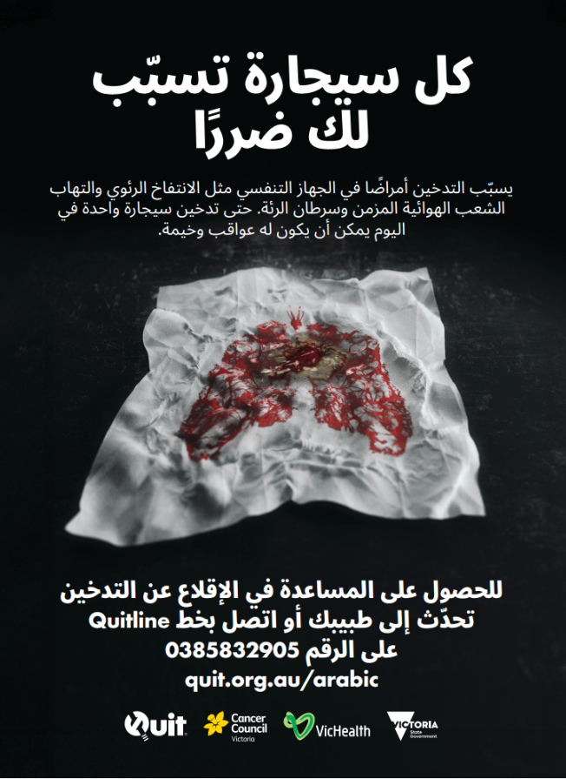
Poster 1: The Hanky campaign poster (A3)
Headline:
Every cigarette is doing you damage | كل سيجارة تسبّب لك ضررًا
Body copy above tissue:
Smoking causes respiratory illnesses like emphysema, chronic bronchitis and lung cancer. Even one a day can have serious consequences. | يسبّب التدخين أمراضًا في الجهاز التنفسي مثل الانتفاخ الرئوي والتهاب الشعب الهوائية المزمن وسرطان الرئة. حتى تدخين سيجارة واحدة في اليوم يمكن أن يكون له عواقب وخيمة.
Body copy below tissue
For help to quit, speak to your doctor or contact Quitline on (03) 8583 2905 | للحصول على المساعدة في الإقلاع عن التدخين تحدّث إلى طبيبك أو اتصل بخط Quitline على الرقم 0385832905
Order hardcopies

Slide 11
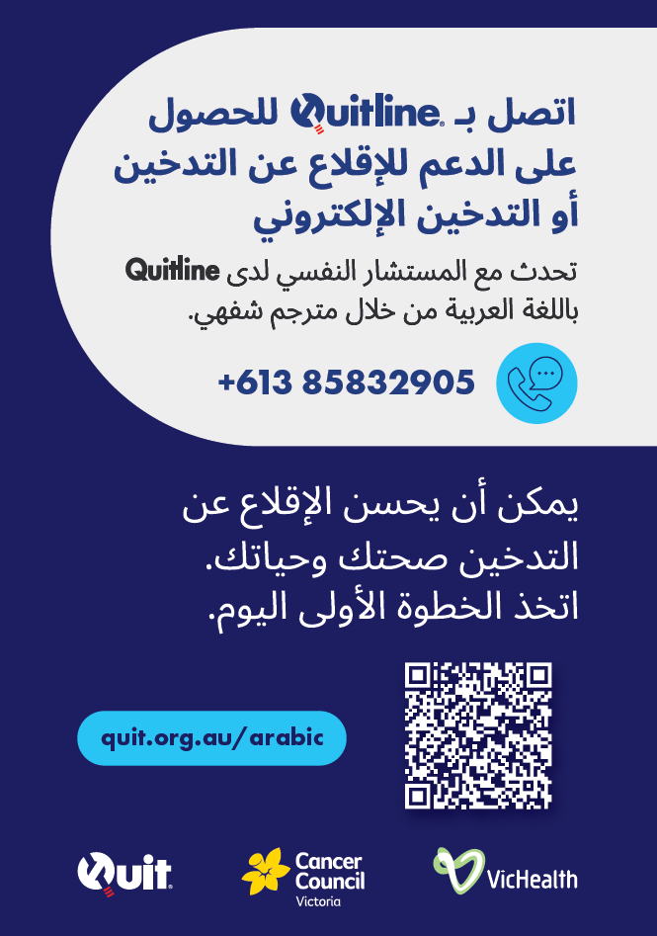
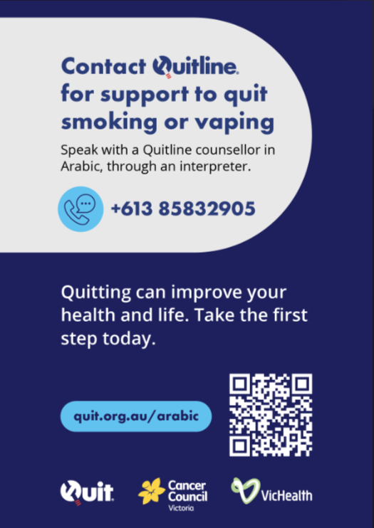
Poster 2: Quitline poster (A3)
Order hardcopies

Slide 12
Sample copy for your website/newsletters
Arabic is read from right to left. To select Arabic text, highlight text from top right to bottom left (like how you would read it).
Headline:
كل سيجارة تسبّب لك ضررًا
Body Copy:
التدخين ضار بالرئتين ويمكن أن يؤدي إلى أمراض خطيرة في الجهاز التنفسي مثل الانتفاخ الرئوي والتهاب الشعب الهوائية المزمن وسرطان الرئة. حتى التدخين مرة واحدة يوميًا يمكن أن يسبب ضررًا لرئتيك.
ولكن الأوان لم يفت بعد للإقلاع عن التدخين. الإقلاع عن التدخين يمكن أن يحسّن صحتك ويقلّل من خطر إصابتك بأمراض في الجهاز التنفسي.
Headline:
الإقلاع عن التدخين
Body Copy:
الإقلاع عن التدخين رحلة تتخللها لحظات من النجاح والتحدّيات. تذكّر أن كل محاولة لها أهميتها وفي كل مرة تقلع عن التدخين يصبح الأمر أسهل. نحن نتفهّم ما تمرّ به، ونحن موجودون لمساعدتك.
المرشدون لدى Quitline هم محترفون مؤهلون لمساعدة الأشخاص على الإقلاع عن التدخين. وسيعملون معك لمساعدتك على إيجاد الحافز وعدم التراجع، وسيضعون خطة فردية تناسب احتياجاتك، ويقدمون التوجيه والتشجيع طوال الوقت.
تحدّث إلى طبيبك أو الصيدلي حول كيفية التوقّف عن التدخين وما إذا كانت أدوية التوقّف عن التدخين مناسبة لك.
Headline:
اتصل بأحد المرشدين العاملين لدى Quitline اليوم
Body copy:
يمكن للمرشدين العاملين لدى Quitline التحدّث معك بلغتك من خلال خدمات الترجمة الفورية. يرجى الاتصال برقم الهاتف المناسب المذكور أدناه واتباع التعليمات لترك رسالة. وسيقوم أحد المرشدين العاملين لدى Quitline بالاتصال بك من خلال خدمات الترجمة الفورية:
يُرجى الاتصال بالرقم 0385832905quit.org.au/arabic
Headline:
Every cigarette is doing you damage
Body Copy:
Smoking is harmful to your lungs and can lead to serious respiratory illnesses like emphysema, chronic bronchitis, and lung cancer. Even smoking once a day can cause damage to your lungs. But it's not too late to quit. Quitting smoking can improve your health and reduce your risk of respiratory illnesses.
Headline:
Quitting smoking
Body Copy:
Quitting smoking is a journey with ups and downs. Remember, every try counts and every time you quit you get better at it. We understand what you are going through, and we are here to help.
Quitline counsellors are professionals qualified to help people quit smoking. They will work with you to help you build and keep up your motivation, create a personalised plan that works for you, and provide guidance and encouragement along the way.
Talk to your doctor or pharmacist about how to stop smoking and if stop smoking medications are right for you.
Headline:
Contact a Quitline counsellor today
Body copy:
Quitline counsellors can speak to you in your language through interpretation services. Please call the relevant phone number listed below and follow the instructions to leave a message. A Quitline counsellor will call you back through interpretation services: Please call (03) 8583 2905 quit.org.au/arabic

Slide 13
Website: quit.org.au/arabic
There will be a dedicated in-language landing page for the campaign that will provide general information about the harms of smoking and how to access support to quit, including Quitline.
The webpage content is currently in translation and will be available prior to campaign launch date.

Slide 14
Mandarin/Simplified Chinese Creative

Slide 15
Video
15s - Quitline
Script:
Smoking causes respiratory illnesses like emphysema, chronic bronchitis and lung cancer. Even smoking once a day can have consequences. For help to quit, contact Quitline. | 吸烟会导致呼吸道疾病， 比如肺气肿、慢性支气管炎和肺癌。 即使每天只抽一次烟，也可能导致有害后果。 如需戒烟帮助，请联系Quitline。
Super:
Every cigarette is doing you damage. For help to quit, contact Quitline (03) 8583 2903 (03) 8583 2903 / quit.org.au/chinese | 每抽一根烟，都会损害您的健康。 如需戒烟帮助，请联系Quitline (03) 8583 2903 (03) 8583 2903 / quit.org.au/Chinese
Share this link:
https://youtu.be/bG4oPG1VnMs
Use the YouTube link to share the video on your channels.

Slide 16
Video
15s - Doctor
Script:
Smoking causes respiratory illnesses like emphysema, chronic bronchitis and lung cancer. Even smoking once a day can have consequences. Speak to your doctor about quitting. | 吸烟会导致呼吸道疾病， 比如肺气肿、慢性支气管炎和肺癌。 即使每天只抽一次烟，也可能导致有害后果。 请向医生咨询如何戒烟。
Super:
Every cigarette is doing you damage. For help to quit, speak to your doctor. quit.org.au/chinese | 每抽一根烟，都会损害您的健康。 如需戒烟帮助，请咨询医生。 quit.org.au/chinese
Share this link:
https://youtu.be/357_CpQRnk8
Use the YouTube link to share the video on your channels.

Slide 17
Video
30s - Quitline
Script:
Smoking causes toxic particles from cigarettes to deposit directly in the lungs, which causes immense damage. The lung damage that smoking causes can lead to respiratory illnesses including emphysema, chronic bronchitis and lung cancer. Even smoking once a day can have serious consequences. For help to quit contact Quitline on (03) 8583 2903 | 吸烟会导致香烟里的有毒颗粒直接沉积在肺中，从而造成巨大损伤。 吸烟造成的肺部损伤可能导致呼吸道疾病，包括肺气肿、慢性支气管炎和肺癌。 即使每天只抽一次烟，也可能导致严重后果。如需戒烟帮助，请联系Quitline (03) 8583 2903
Super:
Every cigarette is doing you damage. For help to quit, contact Quitline (03) 8583 2903 (03) 8583 2903 / quit.org.au/chinese | 每抽一根烟，都会损害您的健康。 如需戒烟帮助，请联系Quitline (03) 8583 2903 (03) 8583 2903 / quit.org.au/chinese
Share this link:
https://youtu.be/pxXugfFcSow
Use the YouTube link to share the video on your channels.

Slide 18
Video
30s - Doctor
Script:
Smoking causes toxic particles from cigarettes to deposit directly in the lungs, which causes immense damage. The lung damage that smoking causes can lead to respiratory illnesses including emphysema, chronic bronchitis and lung cancer. Even smoking once a day can have serious consequences. For help to quit, speak to your doctor. | 吸烟会导致香烟里的有毒颗粒直接沉积在肺中，从而造成巨大损伤。 吸烟造成的肺部损伤可能导致呼吸道疾病，包括肺气肿、慢性支气管炎和肺癌。 即使每天只抽一次烟，也可能导致严重后果。如需戒烟帮助，请咨询医生。
Super:
Every cigarette is doing you damage. For help to quit, speak to your doctor. quit.org.au/chinese | 每抽一根烟，都会损害您的健康。 如需戒烟帮助，请咨询医生。 quit.org.au/chinese
Share this link:
https://youtu.be/Mw40Pv7bAmI
Use the YouTube link to share the video on your channels.

Slide 19
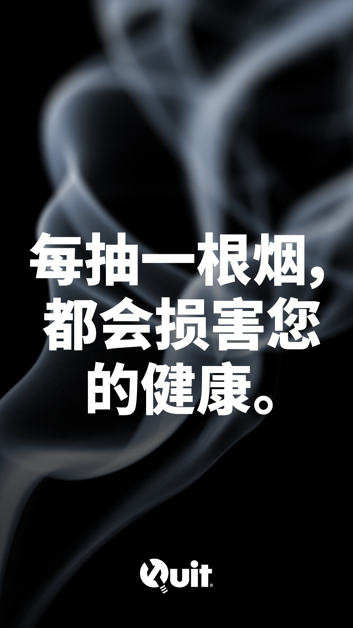
Social media tiles & sample post
Remember to tag and follow Quit on: Facebook and X (formerly Twitter) @quitvic | LinkedIn @quit-victoria
Headline:
It’s time to quit. | 该戒烟了。
Body Copy:
The lung damage that smoking causes can lead to respiratory illnesses including emphysema, chronic bronchitis and lung cancer. | 吸烟造成的肺部损伤可能导致呼吸道疾病，包括肺气肿、慢性支气管炎和肺癌。
Tile Copy:
Every cigarette is doing you damage. | 每抽一根烟，都会损害您的健康。
Call to action:
For help to quit, contact Quitline (03) 8583 2903 / quit.org.au/chinese | 如需戒烟帮助，请联系Quitline (03) 8583 2903 quit.org.au/chinese
Headline:
It’s time to quit. | 该戒烟了。
Body copy:
Smoking causes toxic particles from cigarettes to deposit directly in the lungs, which causes immense damage. | 吸烟会导致香烟里的有毒颗粒直接沉积在肺中，从而造成巨大损伤。
Tile Copy:
Every cigarette is doing you damage. | 每抽一根烟，都会损害您的健康。
Call to action:
For help to quit, contact Quitline (03) 8583 2903 / quit.org.au/chinese | 如需戒烟帮助，请联系Quitline (03) 8583 2903 quit.org.au/chinese

Slide 20
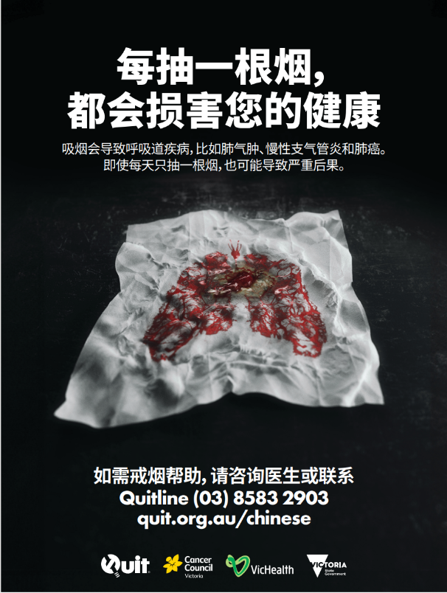
Poster 1: The Hanky campaign poster (A3)
Headline:
Every cigarette is doing you damage | 每抽一根烟，都会损害您的健康
Body copy above tissue:
Smoking causes respiratory illnesses like emphysema, chronic bronchitis and lung cancer. Even one a day can have serious consequences. | 吸烟会导致呼吸道疾病，比如肺气肿、慢性支气管炎和肺癌。即使每天只抽一根烟，也可能导致严重后果。
Body copy below tissue
For help to quit, speak to your doctor or contact Quitline on (03) 8583 2903 | 如需戒烟帮助，请咨询医生或联系Quitline (03) 8583 2903
Order hardcopies

Slide 21
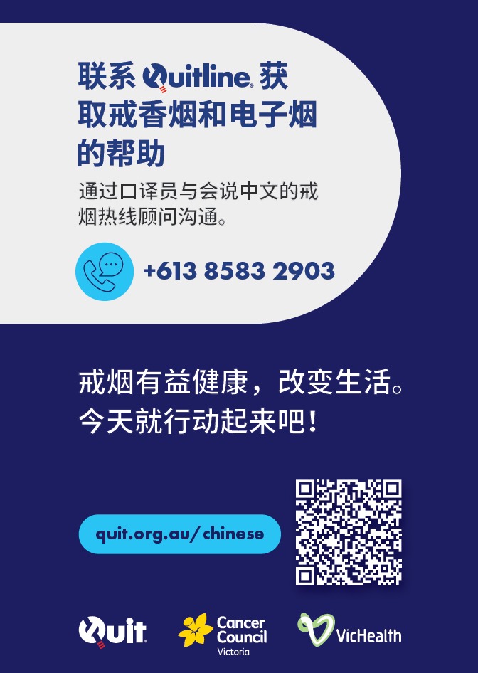
Poster 2: Quitline poster (A3)
Poster reads:
Contact Quitline for support to quit smoking or vaping
Speak with a Quitline counsellor in Mandarin, through an interpreter
+613 85832903
Quitting can improve your health and life. Take the first step today.
quit.org.au/chinese
Order hardcopies

Slide 22
Sample copy for your website/newsletters
Headline:
Every cigarette is doing you damage
Body Copy:
Smoking is harmful to your lungs and can lead to serious respiratory illnesses like emphysema, chronic bronchitis, and lung cancer. Even smoking once a day can cause damage to your lungs.
But it's not too late to quit. Quitting smoking can improve your health and reduce your risk of respiratory illnesses.
Headline:
Quitting smoking
Body Copy:
Quitting smoking is a journey with ups and downs. Remember, every try counts and every time you quit you get better at it. We understand what you are going through, and we are here to help.
Quitline counsellors are professionals qualified to help people quit smoking. They will work with you to help you build and keep up your motivation, create a personalised plan that works for you, and provide guidance and encouragement along the way.
Talk to your doctor or pharmacist about how to stop smoking and if stop smoking medications are right for you.
Headline:
Contact a Quitline counsellor today
Body copy:
Quitline counsellors can speak to you in your language through interpretation services. Please call the relevant phone number listed below and follow the instructions to leave a message. A Quitline counsellor will call you back through interpretation services:
Please call (03) 8583 2903 quit.org.au/chinese
Headline:
每抽一根烟，都会损害您的健康
Body Copy:
吸烟对肺部有害，可能导致严重呼吸道疾病，比如肺气肿、慢性支气管炎和肺癌。即使每天只抽一次烟，也可能对您的肺部造成损伤。
任何时候戒烟都不会为时过晚。戒烟能改善您的健康，降低您患呼吸道疾病的风险。
Headline:
戒烟
Body Copy:
戒烟过程不会一帆风顺。请记住，每一次尝试都很重要，都会使您在戒烟道路上更进一步。我们了解您在戒烟过程中会经历什么，可为您提供帮助。
Quitline心理辅导员是具备资质的专业人员，能帮助人们戒烟。他们会与您合作，帮助您建立信心、保持动力，制定适合您的个人计划，并全程为您提供引导和鼓励。
请向医生或药剂师咨询如何戒烟以及适合您的戒烟药物。
Headline:
现在就联系Quitline心理辅导员
Body copy:
Quitline心理辅导员可以通过口译服务与您用中文交流。请拨打以下电话号码，根据提示留言。一名Quitline心理辅导员会通过口译服务给您回电：
请致电(03) 8583 2903 quit.org.au/chinese

Slide 23
Website: quit.org.au/chinese
There will be a dedicated in-language landing page for the campaign that will provide general information about the harms of smoking and how to access support to quit, including Quitline.
The webpage content is currently in translation and will be available prior to campaign launch date.

Slide 24
Vietnamese Creative

Slide 25
Video
15s - Quitline
Script:
Smoking causes respiratory illnesses like emphysema, chronic bronchitis and lung cancer. Even smoking once a day can have consequences. For help to quit, contact Quitline. | Hút thuốc lá gây ra các bệnh đường hô hấp như khí phế thũng, viêm phế quản mãn tính và ung thư phổi. Chỉ cần hút thuốc lá một lần mỗi ngày cũng có thể để lại hậu quả. Muốn nhận trợ giúp để bỏ thuốc lá, hãy liên lạc với Quitline.
Super:
Every cigarette is doing you damage. For help to quit, contact Quitline (03) 8583 2906 (03) 8583 2906 / quit.org.au/vietnamese | Mỗi điếu thuốc lá đều gây hại cho bạn. Muốn nhận trợ giúp để bỏ thuốc lá, hãy liên lạc với Quitline theo số (03) 8583 2906 (03) 8583 2906 / quit.org.au/vietnamese
Share this link:
https://youtu.be/qNUSwOsST6I
Use the YouTube link to share the video on your channels.

Slide 26
Video
15s - Doctor
Script:
Smoking causes respiratory illnesses like emphysema, chronic bronchitis and lung cancer. Even smoking once a day can have consequences. Speak to your doctor about quitting. | Hút thuốc lá gây ra các bệnh đường hô hấp như khí phế thũng, viêm phế quản mãn tính và ung thư phổi. Chỉ cần hút thuốc lá một lần mỗi ngày cũng có thể để lại hậu quả. Hãy nói chuyện với bác sĩ về việc bỏ thuốc lá.
Super:
Every cigarette is doing you damage. For help to quit, speak to your doctor. quit.org.au/vietnamese | Mỗi điếu thuốc lá đều gây hại cho bạn. Muốn nhận trợ giúp để bỏ thuốc lá, hãy nói chuyện với bác sĩ. quit.org.au/vietnamese
Share this link:
https://youtu.be/gHN8dZpuiNc
Use the YouTube link to share the video on your channels.

Slide 27
Video
Script:
Smoking causes toxic particles from cigarettes to deposit directly in the lungs, which causes immense damage. The lung damage that smoking causes can lead to respiratory illnesses including emphysema, chronic bronchitis and lung cancer. Even smoking once a day can have serious consequences. For help to quit contact Quitline on (03) 8583 2906 | Hút thuốc lá khiến các hạt bụi độc hại từ thuốc lá bám sâu trực tiếp vào phổi, gây ra tổn thương rất nghiêm trọng. Tổn thương phổi do hút thuốc lá có thể dẫn đến các bệnh đường hô hấp bao gồm khí phế thũng, viêm phế quản mãn tính và ung thư phổi. Chỉ cần hút thuốc lá một lần mỗi ngày cũng có thể gây ra hậu quả nghiêm trọng. Muốn nhận trợ giúp để bỏ thuốc lá, hãy liên lạc với Quitline theo số (03) 8583 2906
Super:
Every cigarette is doing you damage. For help to quit, contact Quitline (03) 8583 2906 (03) 8583 2906 / quit.org.au/vietnamese | Mỗi điếu thuốc lá đều gây hại cho bạn. Muốn nhận trợ giúp để bỏ thuốc lá, hãy liên lạc với Quitline theo số (03) 8583 2906 (03) 8583 2906 / quit.org.au/Vietnamese
30s - Quitline
Share this link:
https://youtu.be/6QqtcCvwzqM
Use the YouTube link to share the video on your channels.

Slide 28
Video
30s - Doctor
Script:
Smoking causes toxic particles from cigarettes to deposit directly in the lungs, which causes immense damage. The lung damage that smoking causes can lead to respiratory illnesses including emphysema, chronic bronchitis and lung cancer. Even smoking once a day can have serious consequences. For help to quit, speak to your doctor. | Hút thuốc lá khiến các hạt bụi độc hại từ thuốc lá bám sâu trực tiếp vào phổi, gây ra tổn thương rất nghiêm trọng. Tổn thương phổi do hút thuốc lá có thể dẫn đến các bệnh đường hô hấp bao gồm khí phế thũng, viêm phế quản mãn tính và ung thư phổi. Chỉ cần hút thuốc lá một lần mỗi ngày cũng có thể gây ra hậu quả nghiêm trọng. Muốn nhận trợ giúp để bỏ thuốc lá, hãy nói chuyện với bác sĩ.
Super:
Every cigarette is doing you damage. For help to quit, speak to your doctor. quit.org.au/vietnamese | Mỗi điếu thuốc lá đều gây hại cho bạn. Muốn nhận trợ giúp để bỏ thuốc lá, hãy nói chuyện với bác sĩ. quit.org.au/vietnamese
Share this link:
https://youtu.be/Rzb4Ulci0DE
Use the YouTube link to share the video on your channels.

Slide 29
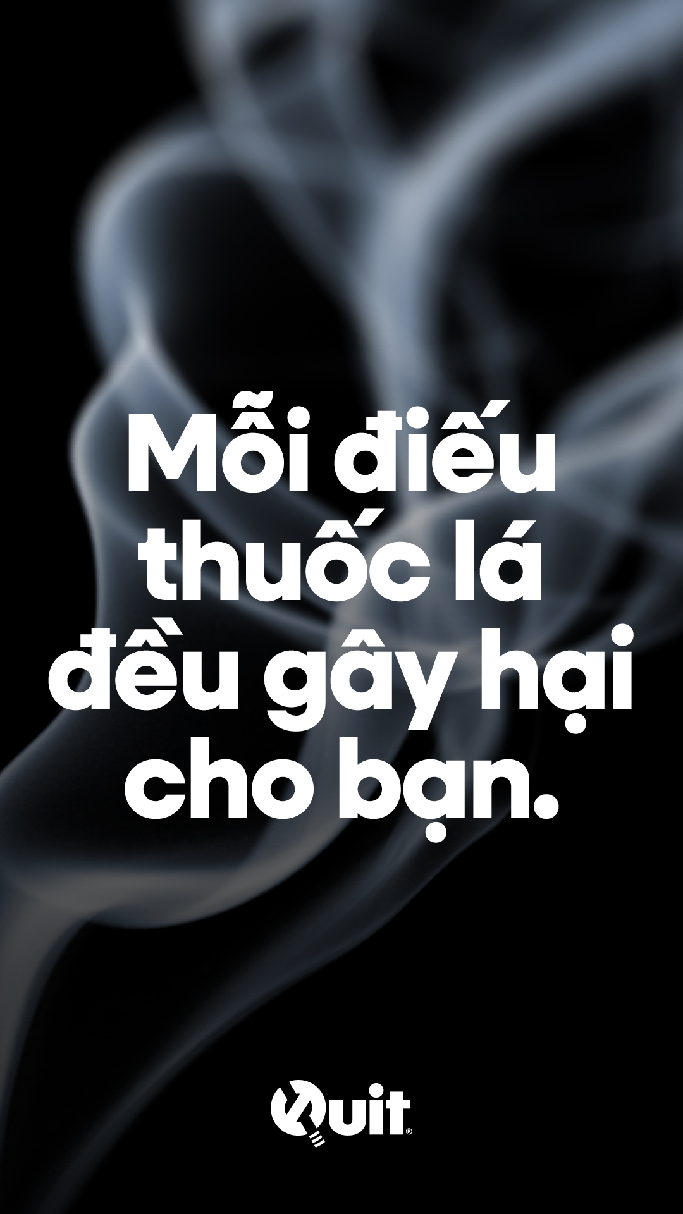
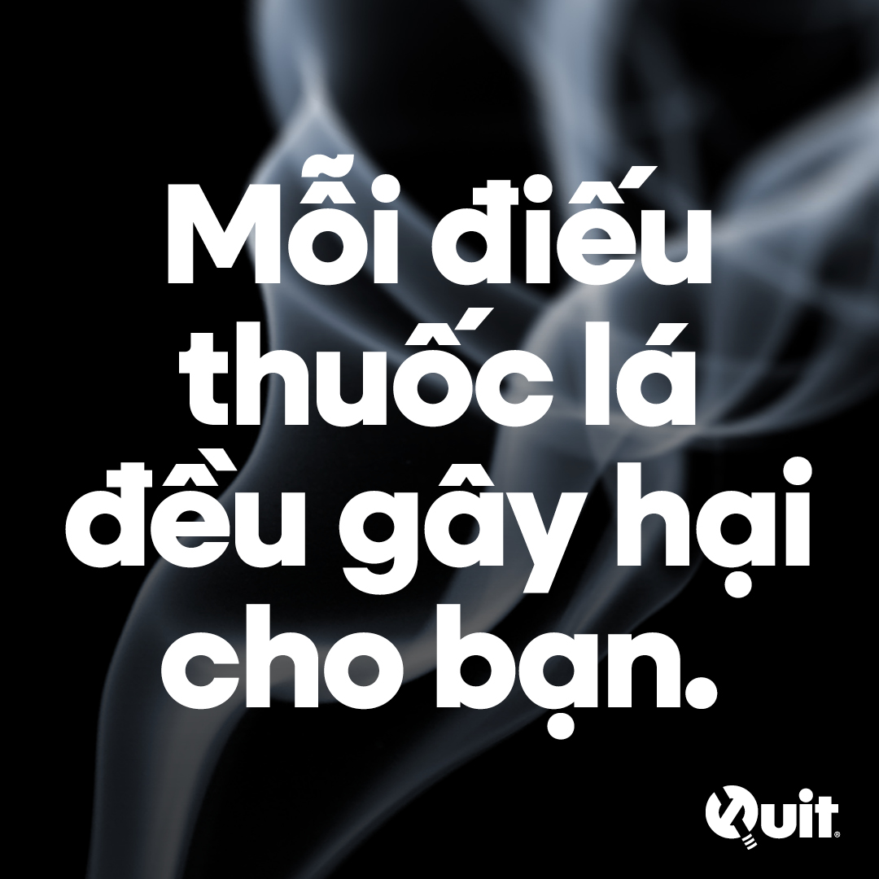
Social media tiles & sample post
Remember to tag and follow Quit on: Facebook and X (formerly Twitter) @quitvic | LinkedIn @quit-victoria
Headline:
It’s time to quit. | Đã đến lúc nên bỏ thuốc lá.
Body Copy:
The lung damage that smoking causes can lead to respiratory illnesses including emphysema, chronic bronchitis and lung cancer. | Tổn thương phổi do hút thuốc lá có thể dẫn đến các bệnh đường hô hấp bao gồm khí phế thũng, viêm phế quản mãn tính và ung thư phổi.
Tile Copy:
Every cigarette is doing you damage. | Mỗi điếu thuốc lá đều gây hại cho bạn.
Call to action:
For help to quit, contact Quitline (03) 8583 2906 / quit.org.au/vietnamese | Muốn nhận trợ giúp để bỏ thuốc lá, hãy liên lạc với Quitline theo số (03) 8583 2906 quit.org.au/vietnamese
Headline:
It’s time to quit. | Đã đến lúc nên bỏ thuốc lá.
Body copy:
Smoking causes toxic particles from cigarettes to deposit directly in the lungs, which causes immense damage. | Hút thuốc lá khiến các hạt bụi độc hại từ thuốc lá bám sâu trực tiếp vào phổi, gây ra tổn thương rất nghiêm trọng.
Tile Copy:
Every cigarette is doing you damage. | Mỗi điếu thuốc lá đều gây hại cho bạn.
Call to action:
For help to quit, contact Quitline (03) 8583 2906 / quit.org.au/Vietnamese | Muốn nhận trợ giúp để bỏ thuốc lá, hãy liên lạc với Quitline theo số (03) 8583 2906 quit.org.au/Vietnamese

Slide 30
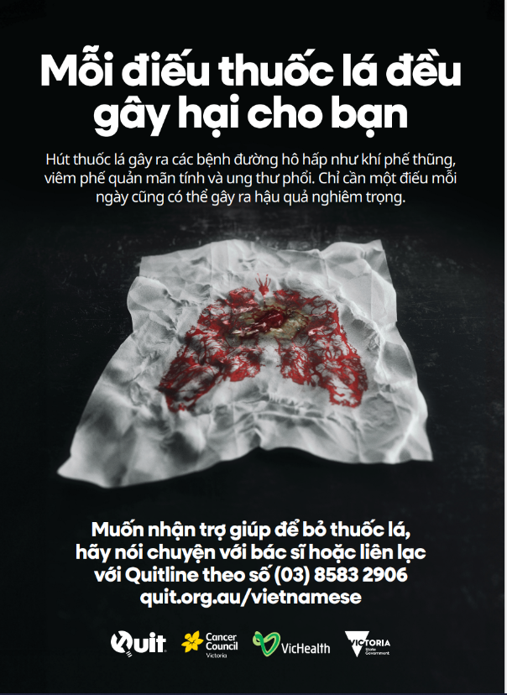
Poster 1: The Hanky campaign poster (A3)
Headline:
Every cigarette is doing you damage | Mỗi điếu thuốc lá đều gây hại cho bạn
Body copy above tissue:
Smoking causes respiratory illnesses like emphysema, chronic bronchitis and lung cancer. Even one a day can have serious consequences. | Hút thuốc lá gây ra các bệnh đường hô hấp như khí phế thũng, viêm phế quản mãn tính và ung thư phổi. Chỉ cần một điếu mỗi ngày cũng có thể gây ra hậu quả nghiêm trọng.
Body copy below tissue
For help to quit, speak to your doctor or contact Quitline on (03) 8583 2906 | Muốn nhận trợ giúp để bỏ thuốc lá, hãy nói chuyện với bác sĩ hoặc liên lạc với Quitline theo số (03) 8583 2906
Order hardcopies

Slide 31
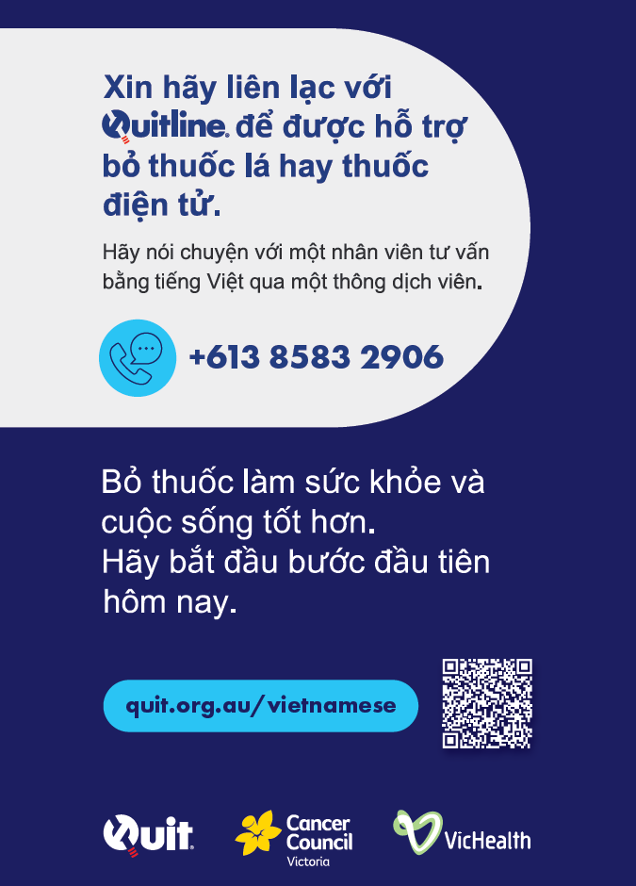
Poster 2: Quitline poster (A3)
Poster reads:
Contact Quitline for support to quit smoking or vaping
Speak with a Quitline counsellor in Vietnamese, through an interpreter
+613 85832906
Quitting can improve your health and life. Take the first step today.
quit.org.au/chinese
Order hardcopies

Slide 32
Sample copy for your website/newsletters
Headline:
Every cigarette is doing you damage
Body Copy:
Smoking is harmful to your lungs and can lead to serious respiratory illnesses like emphysema, chronic bronchitis, and lung cancer. Even smoking once a day can cause damage to your lungs.
But it's not too late to quit. Quitting smoking can improve your health and reduce your risk of respiratory illnesses.
Headline:
Quitting smoking
Body Copy:
Quitting smoking is a journey with ups and downs. Remember, every try counts and every time you quit you get better at it. We understand what you are going through, and we are here to help.
Quitline counsellors are professionals qualified to help people quit smoking. They will work with you to help you build and keep up your motivation, create a personalised plan that works for you, and provide guidance and encouragement along the way.
Talk to your doctor or pharmacist about how to stop smoking and if stop smoking medications are right for you.
Headline:
Contact a Quitline counsellor today
Body copy:
Quitline counsellors can speak to you in your language through interpretation services. Please call the relevant phone number listed below and follow the instructions to leave a message. A Quitline counsellor will call you back through interpretation services:
Please call (03) 8583 2906
Headline:
Mỗi điếu thuốc lá đều gây hại cho bạn
Body Copy:
Hút thuốc lá gây hại cho phổi và có thể dẫn đến các bệnh đường hô hấp nghiêm trọng như khí phế thũng, viêm phế quản mãn tính và ung thư phổi. Chỉ cần hút thuốc lá một lần mỗi ngày cũng có thể gây ra tổn thương cho phổi.
Nhưng vẫn chưa quá muộn để bỏ thuốc lá. Bỏ thuốc lá có thể cải thiện sức khỏe và giảm nguy cơ mắc bệnh đường hô hấp.
Headline:
Bỏ thuốc lá
Body Copy:
Bỏ thuốc lá là một hành trình lúc lên lúc xuống. Hãy nhớ rằng, mọi nỗ lực đều có giá trị và mỗi lần bỏ thuốc lá, bạn sẽ làm tốt hơn. Chúng tôi hiểu những gì bạn đang trải qua và luôn sẵn sàng trợ giúp.
Các cố vấn của Quitline là những chuyên gia có chuyên môn để giúp mọi người bỏ thuốc lá. Họ sẽ làm việc với bạn để giúp bạn tạo ra và duy trì động lực, lập kế hoạch phù hợp với bạn, đồng thời đưa ra hướng dẫn và động viên bạn trong suốt chặng đường.
Hãy nói chuyện với bác sĩ hoặc dược sĩ về cách bỏ thuốc lá và xem các thuốc hỗ trợ bỏ thuốc lá có phù hợp với bạn hay không.
Headline:
Hãy liên lạc với cố vấn của Quitline ngay hôm nay
Body copy:
Cố vấn của Quitline có thể nói chuyện bằng ngôn ngữ của bạn qua dịch vụ thông ngôn. Vui lòng gọi đến số điện thoại phù hợp được liệt kê bên dưới và làm theo hướng dẫn để để lại lời nhắn. Cố vấn của Quitline sẽ gọi lại cho bạn qua dịch vụ thông ngôn:
Vui lòng gọi số (03) 8583 2906 quit.org.au/vietnamese

Slide 33
Website: quit.org.au/vietnamese
There will be a dedicated in-language landing page for the campaign that will provide general information about the harms of smoking and how to access support to quit, including Quitline.
The webpage content is currently in translation and will be available prior to campaign launch date.

Slide 34
Multi-language

Slide 35
Poster 3: Multi-lingual Quitline poster (A3)
Poster reads:
Contact Quitline for support to quit smoking or vaping.
Presented in (from left to right):
Simplified Chinese
Hindi
Vietnamese
Greek
Arabic
Order hardcopies

Slide 36
For further information
For campaign information visit quit.org.au/the-hanky-campaign-toolkit
For further assistance email QuitVicCommunities@cancervic.org.au

